Slide 1

Data Science Infrastructure as Code
Higher Intelligence. Deeper Insights. Smarter Decisions.
Gagandeep Singh, Sr. Data Scientist
Cascadia R Conference, June 8th, 2019

Slide 2

Senior Data Scientist@ProCogia
Proud Husky
R enthusiast
Former RedHat Certified Administrator, Current RStudio Certified Professional Administrator
LinkedIn: linkedin.com/in/gagandeeepuw/
Twitter: @gaganUW

Slide 3


What is the Infrastructure for Data Scientists?

Slide 4

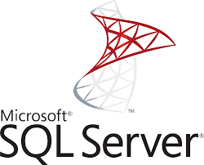

What is the Infrastructure for Data Scientists?

Slide 5


What is the Infrastructure for Data Scientists?
Notes:
Add JIRA

Slide 6


Data Science Infrastructure at Enterprise level

Slide 7

Data Science Infrastructure at Enterprise level

Slide 8


USS Enterprise: An aspiring ‘Data Driven’ Organization

Slide 9

USS Enterprise: An aspiring ‘Data Driven’ Organization

Slide 10

Blue Shirts: Data Scientists
Understand business problems and translate them to analytical questions
Perform extensive data wrangling on data from different sources to find useful features
Build advanced machine learning models and analytical solutions
Design and develop effective methods to communicate results, i.e., dashboards and reports

Slide 11

Red Shirts: DevOps Engineers
Plan, develop, test and maintain enterprise wide infrastructure
Build continuous integration/continuous delivery pipelines
Responsible for automating development and integration of software releases/fixes
Monitor systems’ health and security

Slide 12

Gold Shirts: Analytics Managers
The powers to be that run the organization’s analytics endeavors
Collect and define business use cases, determine effective delivery timelines and allocate resources
Act as liaison between senior level business stakeholders and data scientists
Responsible for providing adequate measures to data scientists for quality output

Slide 13

Overheard at the water cooler…
“It takes a lot of time to test a model on my own computer. How can I make my code run faster?”
“I heard our organization is getting a Jenkins server. What does it mean to me?”
“I read something about Kubernetes and how it can help me process my data faster.”
“I wish there was a centralized platform which I did not have to maintain.”

Slide 14

Overheard at the water cooler…
“I keep getting queries from my managers if we can provide any assistance to data scientists.”
“I wish I had the time to build one more CI/CD pipeline just for data science.”
“Hmmm.. what do these data scientists do anyway?”

Slide 15

Overheard at the water cooler…
“How can I deliver more quality projects on time?”
“My analysts say they need to make sure their models are tested extensively.”
“Is there a way I can utilize all these new age technologies my bosses have paid for already?”
“I don’t have the budget for a data engineer on my team.”

Slide 16
What is missing?

Slide 17

What is missing?

Slide 18

RCogia to the Rescue!
RCogia is a data engineering solution that bridges the gap between data science and DevOps – it fully utilizes the computing prowess of a cloud platform for data science developers to evangelize their insights on an enterprise level.
It seamlessly merges the entire RStudio Product suite with an enterprise’s existing Continuous Integration/Continuous Deployment pipeline.
It allows for seamless automation using any of the popular automation tools such as Terraform, Ansible, Puppet, and more.
Additionally it can be configured to interact with other enterprise infrastructure entities for code sharing, visualization and database management.

Slide 19









RCogia to the Rescue!

Slide 20


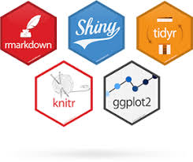

RCogia to the Rescue!

Slide 21
RCogia to the Rescue!

Slide 22
RCogia to the Rescue!

Slide 23
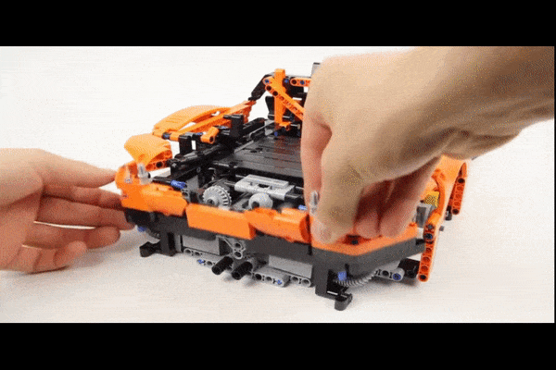
Time to see it in action!

Slide 24
Why RCogia?
Highly customizable solution; designed to be used in a plug-and-play manner
Users can choose automation tool(terraform, ansible, puppet etc.), infrastructure element(Server Pro, Connect etc.) and CI/CD server.
Minimal configuration and maintenance responsibility on DevOps team
Data Scientists can scale up their models and run them in production without worrying about resource constraints
Next iterations will be covering all available machines like RedHat/CentOS and Windows
There is a Python equivalent too! (Guess the name)

Slide 25

Questions?

